Slide 1

City of Durham
Proposed Eno River Withdrawal
EMC – Water Allocation Committee
July 8, 2020
Harold Brady, Division of Water Resources

Slide 2

Outline for Informational Item
Background
Purpose
Location
Eno River Water Management Operations Plan
Proposal Details

Slide 3
Background: EMC’s role in Eno River
Historic low-flow conditions in the Eno River led to a Capacity Use Investigation in 1987. Investigation recommended a Capacity Use Area (CUA) be established.
Development of Water Management Operations Plan (1988) to avoid a formal CUA.
  Voluntary withdrawal restrictions and flowby requirements.
  Agreed to by NCDEQ, primary water users and EMC.
Monitoring and oversight by the NCDEQ.
Should issues arise, voluntary allowance could be rescinded by the EMC and a CUA established.
Considering the EMC’s role in the Eno River, Mr. McAdams, Dr. Meiburg and EMC Counsel recommended NCDEQ staff provide an informational item to the WAC regarding the City of Durham’s proposal.

Slide 4
Proposed Eno River Withdrawals
The City of Durham is proposing to withdrawal water from the Eno River for the explicit purpose of refilling the Teer Quarry.
Existing Durham Eno River emergency intake.
Proposed Durham Eno River intake will be for regular usage.
Proposed "high-flow skimming” withdrawal.
  A specific fraction of the water is allowed to be withdrawn only during times of high flows.
Complicated project with other issues beyond navigating the Water Management Operations Plan. However, NCDEQ and Durham wanted ensure this issue was adequately resolved early in the process.

Slide 5
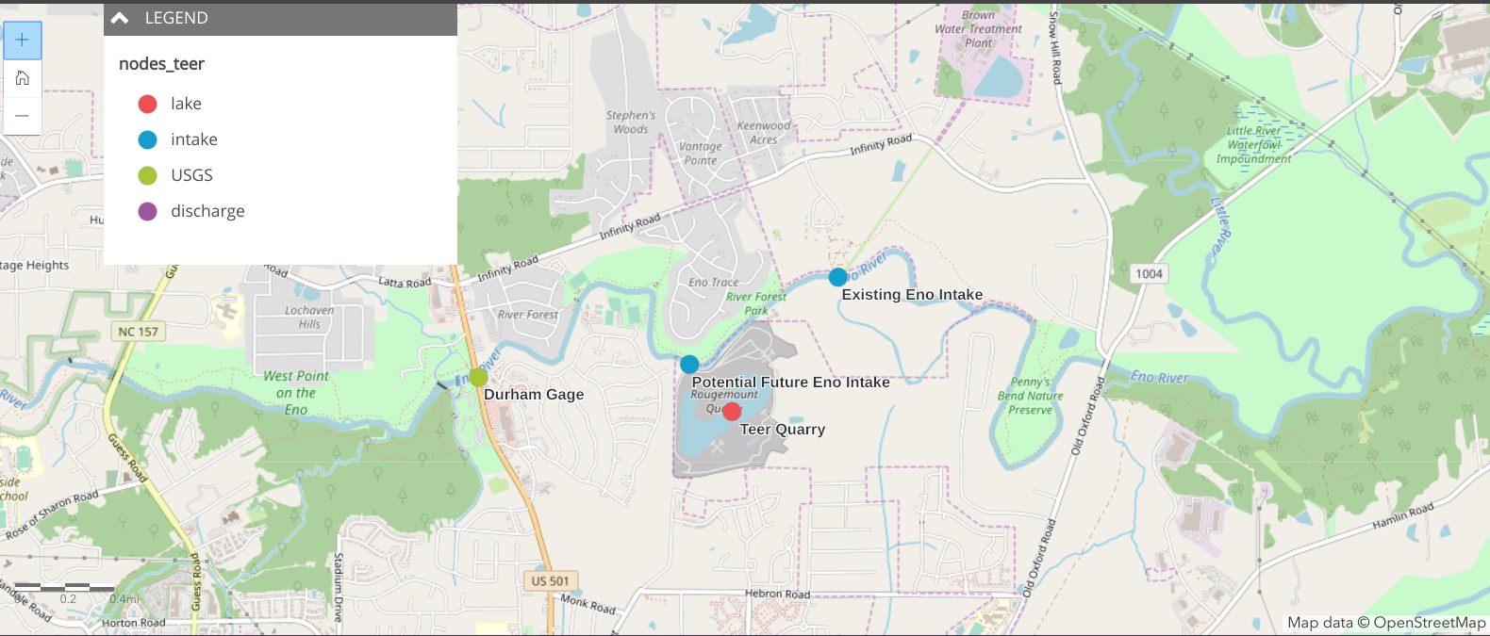
https://ncdenr.maps.arcgis.com/apps/StoryMapBasic/index.html?appid=6fd171eb0b674414b629ee96b37b8294

Slide 6
Eno River Water Management Operations Plan
  Allows for 5 mgd withdrawals by the City of Durham under specific Eno River flow conditions.
    March 1 – May 31 = 30 cfs
    All other times = 10 cfs
  Withdrawals greater than 5 mgd are allowable under the stated flow conditions, but require long-term contracts from outside the basin equal to the amount withdrawn from Eno River.
  There is no explicit guidance for withdrawals exceeding annual median (49 cfs) flow (i.e., high flows).

Slide 7
Proposed Eno River Withdrawal Conditions
Falls Lake must be at or above guide curve (elevation: 251.5’ mean sea level (MSL)) before withdrawals from the Eno River can commence.
Withdrawal rates exceeding 5 mgd will require a flow-by rate of 49 cfs below the withdrawal point, using measurements from the USGS Eno River gage at Durham (US-501).
  Variable flow-by rate based on height of water level in Teer Quarry:
      water level above 254' MSL = 90% flow-by.
      water level below 254' MSL = 80% flow-by.

Slide 8
Proposed Eno River Withdrawal Conditions
Understanding: Withdrawals from the Eno River will be limited to a maximum daily withdrawal of 21.5 mgd (33.2 cfs), unless agreements are secured with the primary partners of the water users group.
    Town of Hillsborough
    Orange-Alamance Water and Sewer Authority
    ResCo (formerly Piedmont Minerals)
    Orange County
  All primary partners have passed resolutions either agreeing or having no objection to the proposal from the City of Durham.

Slide 9
Proposed City of Durham Eno River Withdrawal
  Questions ?
  harold.m.brady@ncdenr.gov

